Slide 1
Inventory Management System
Marcus Alexander Tjomsaas, Andreas Hølleland

Slide 2
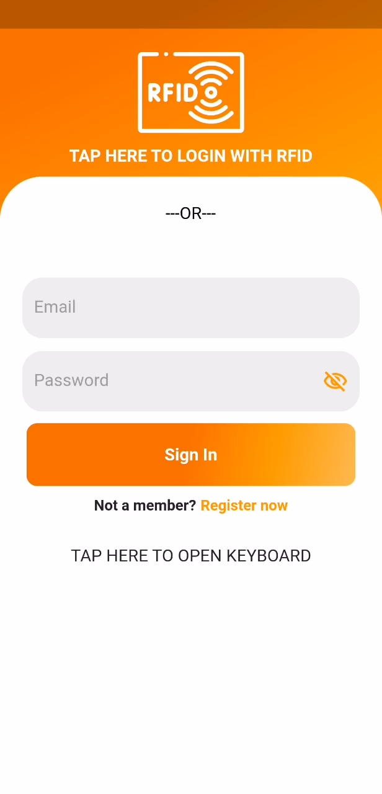
Create user
Register
Email and password
Register
RFID card
Email
Email verification
Sign in
Email and password / RFID card

Slide 3
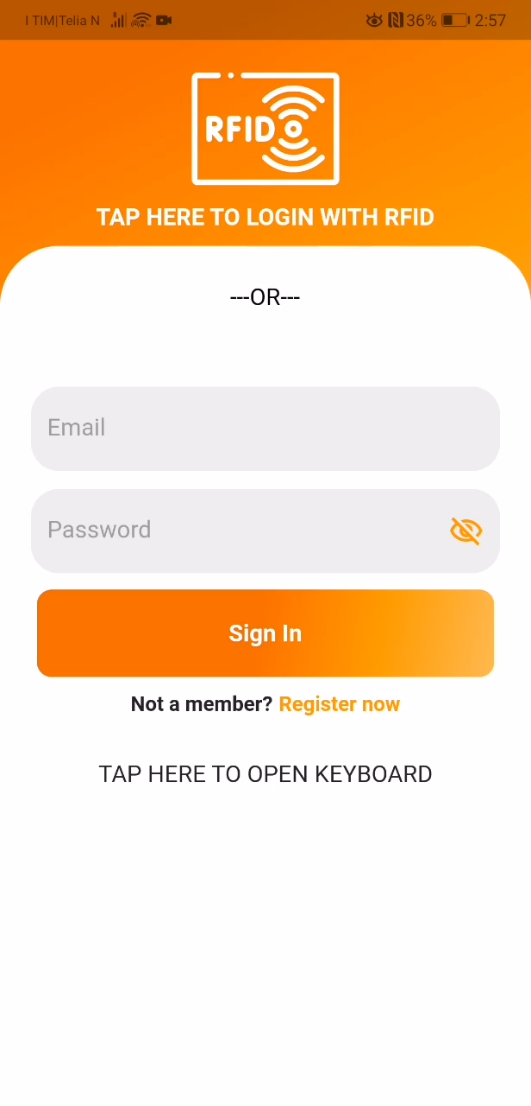
Scan item
Sign in
Email and password / RFID
Borrow item
Scan RFID tag
Return item
Scan RFID tag
Customer
Customer must scan item to confirm return

Slide 4

Customer
Sign in
Email and password / RFID
User
Use the app as a normal user
Email / RFID
Item list
Help user
Shows name, status, description, location and RID
Account list
Shows email and account type

Slide 5
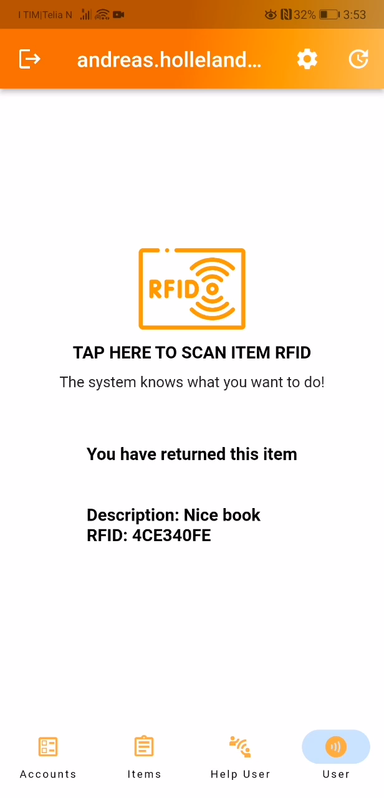
Customer Items
Unassign item
Done in User page
Item must be returned first
Add item
Scan to unassign
Modify item
Delete item
Press the plus symbol
Enter details and scan RFID
Press the pen icon next to an item
Manually change any details and RFID tag
Press the garbage can icon next to an item

Slide 6
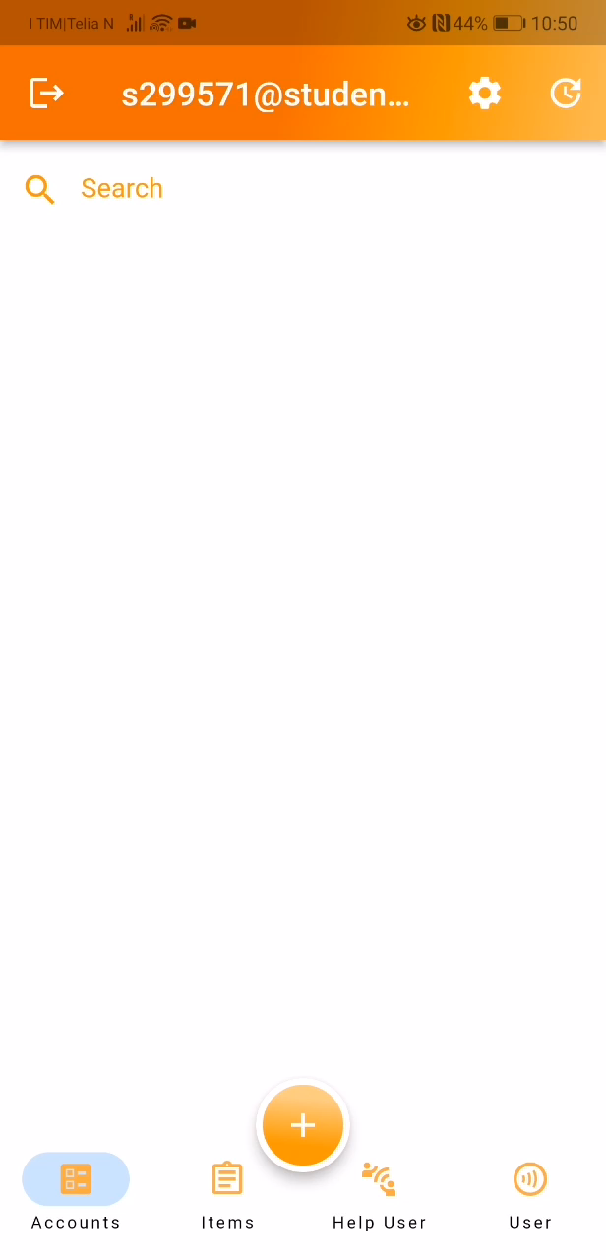
Customer Accounts
Add account
Modify account
Delete account
Press the plus symbol
Enter details and scan RFID
Press the pen icon next to an account
Manually change any details and RFID tag
Press the garbage can icon next to an account (unregisters user from this customer)

Slide 7
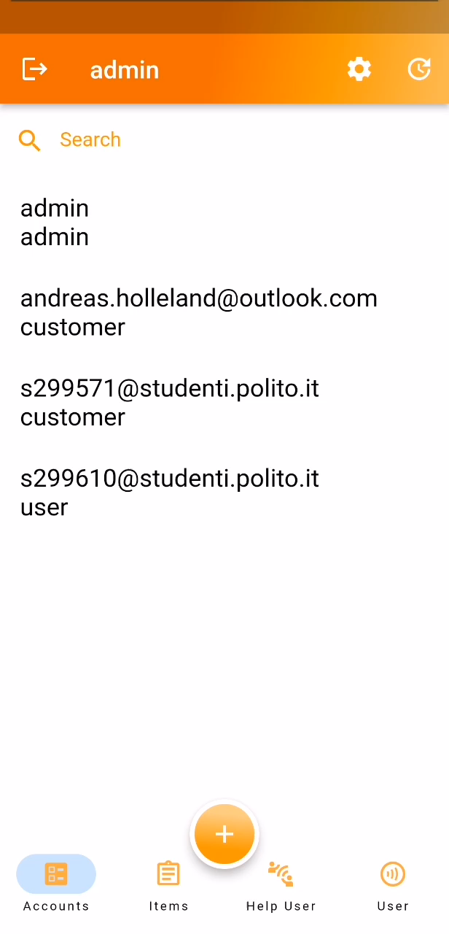
Admin
Add/modify accounts
Add/modify items
Almost the same as for customer
Can also change Customer ID and Registered Customer ID
Almost the same as for customer
Can also change Registered Customer ID
View/modify everything
Create customers
Modify any account or item

Slide 8
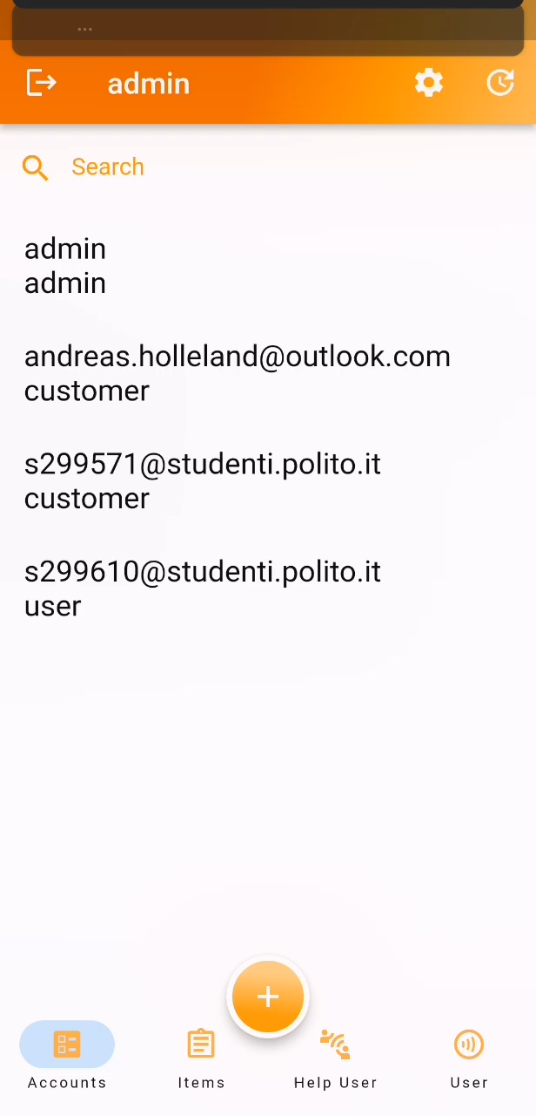
Configuration page
Touch keyboard
Toggle on/off touch keyboard in config page
Can also change Customer ID and Registered Customer ID
Totem config steps
Scan an RFID tag on the totem module to be associated with that totem (first time)
Either read text file on totem or scan associated RFID tag on a phone to get ID.
Enter totem ID in configuration page on the totem

Slide 9
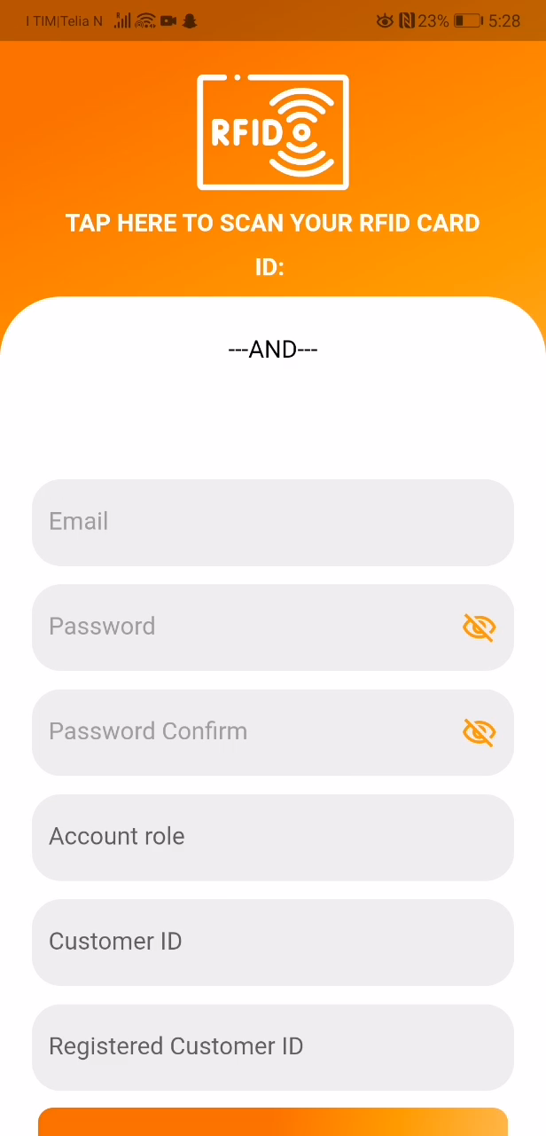
Error checking
Accounts
Existing RFIDs
Matching password
Items
Existing emails
Existing RFID

Slide 10
Setup
Locally hosted server (web app, SQL database)
EmailJS service
Scripts on totem
Bash script runs config and opens web-app in kiosk mode
Python script reads RFID and communicates with server/database

Slide 11
Demo
Git downloads : https://github.com/Tjoms99/Inventory_management
Android: /apps/android/app-release.apk and press download
Windows: clone repo and run /app/windows/flutter_demo.exe
Web: Enter “192.168.43.90/dashboard/web” into chrome or edge
Connect to WiFi (Demo works only on local host)
SSID: grovt
Password: 012345678

